Slide 1
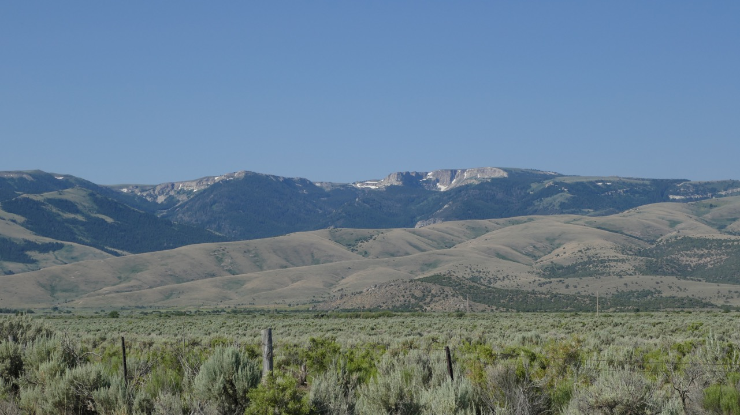
Dating of Major Normal Fault Systems Using Thermochronology: An Example from the Raft River Detachment, Basin & Range, Western United States
Paper by Wells, Snee, & Blythe (2000)
Presentation by Solomon Feinstein

Slide 3
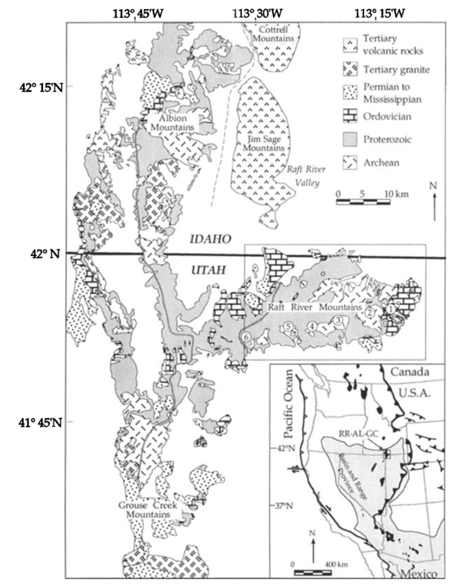
Background Geology
Raft Rivers expose amphibolite to greenschist facies metamorphic rocks of Archean to Permian age in the hinterland of the Sevier Orogeny
The Archean Basement (Green Creek Complex, 2.5 Ga Schist & Monzogranite) is unconformably overlain by the Proterozoic Elba Quartzite (1.5 – 0.7 Ga)
A ductile shear zone and brittle fault are located along the unconformity- the Raft Rivers are an arm of a larger MCC (Albion-Raft River-Grouse Creek MCC, or ARGMCC)
This study seeks to date the timing of deformation along the Raft River Mountains Shear Zone by analyzing 40Ar/39Ar cooling ages and apatite fission tracking in footwall rocks

Slide 4
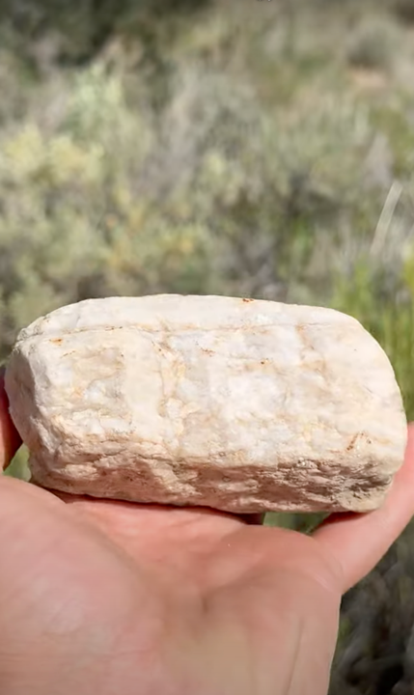
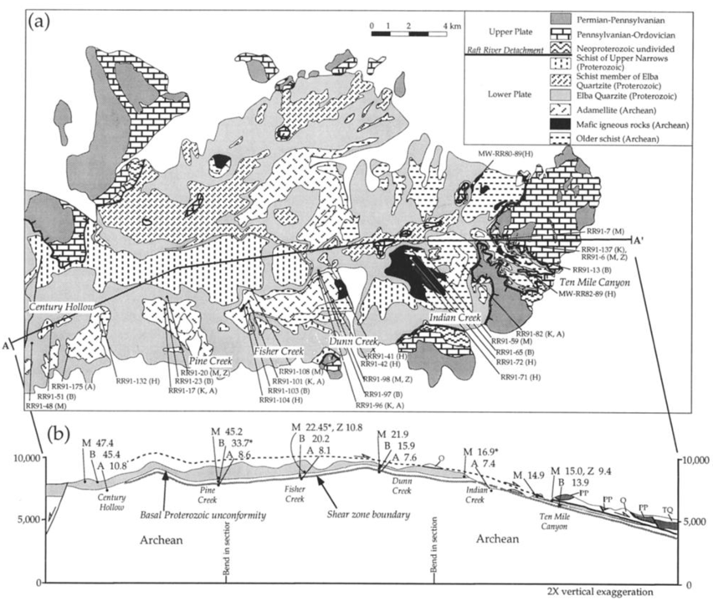

Slide 5
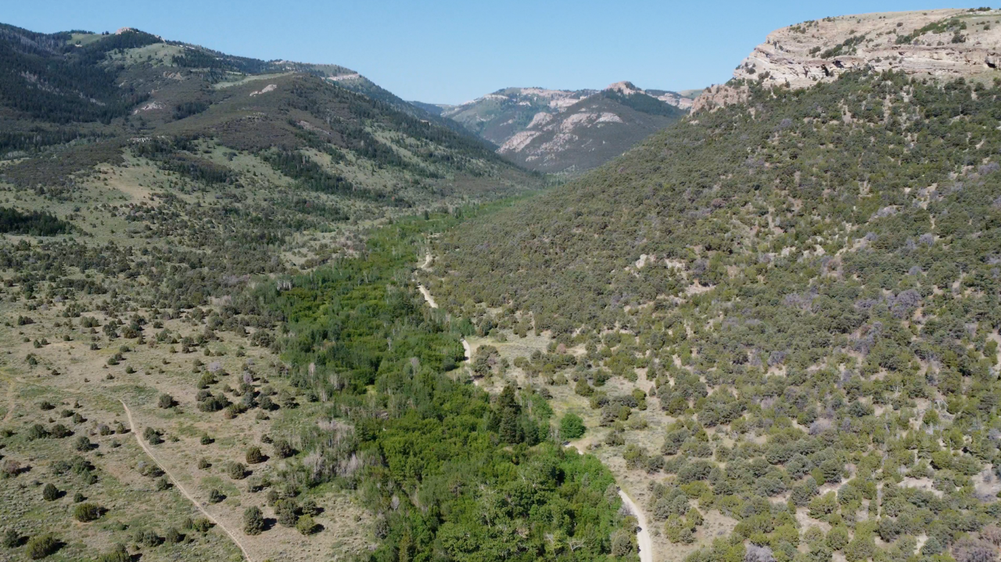

Slide 7
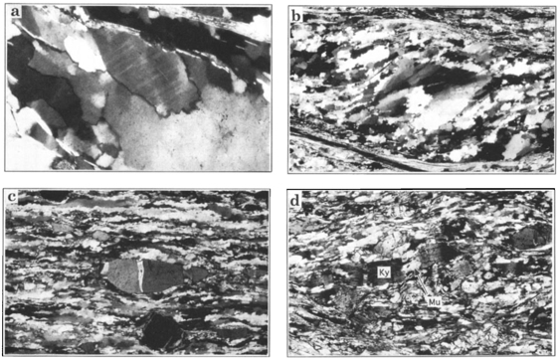
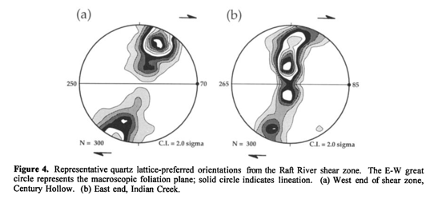
Structural Geology of the Raft River Detachment
The Raft Rivers are a Cordilleran Metamorphic Core Complex
Late Mesozoic to Early Cenozoic Ductile Structures were exhumed along 2 oppositely rooted Cenozoic Decollements
A west-rooted mid Eocene to early Oligocene Shear Zone in the west that was reactivated during the Miocene
The east-rooted Raft River Detachment Fault/Shear Zone (RRSZ) in the central & eastern Raft River Mountains
Both Shear Zones were simultaneously active
Mylonitic fabrics of the RRSZ are highly developed in the hanging wall (Elba Quartzite), with fabric intensity abruptly dying out within the Green Creek Complex (footwall), and exhibit top-to-east shearing

Slide 8
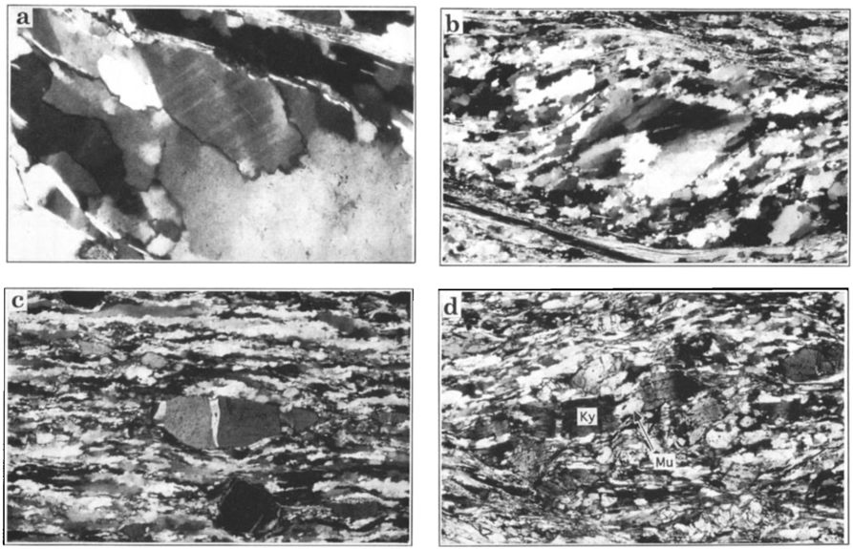
Mylonite & Ductile Deformation- A Closer Look
Deformation lamellae in Quartz
Recrystallized Quartz Grain, exhibiting deformation bands, indicating dextral shearing
Extension fractures of Feldspar Porphyroclast, filled with Quartz & relict fibers, suggesting pressure solution active with dislocation creep in Quartz
Synkinematic growth of Muscovite within micro pull-aparts of Kyanite, indicating plastic deformation conditions of 300-400ºC

Slide 9
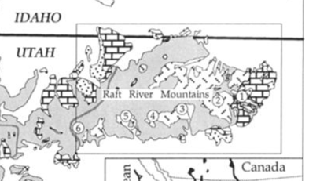
Ar-Ar & Apatite Fission Track Thermochronology
Archean and Proterozoic Rocks of the footwall were collected for thermochronology at locations 4-5 km apart along a 25 km long transect of the range
The transect was extended west 22 more km for apatite fission track analysis
Hornblende, Muscovite, Biotite, Orthoclase, Zircon, & Apatite were analyzed in Ar-Ar Thermochronology

Slide 10
Ar-Ar
West side of sample area shows dates as old as 30 MA
East side of sample area is mainly ~10 MA
Notes:
This shows when the minerals were brought to the surface

Slide 11
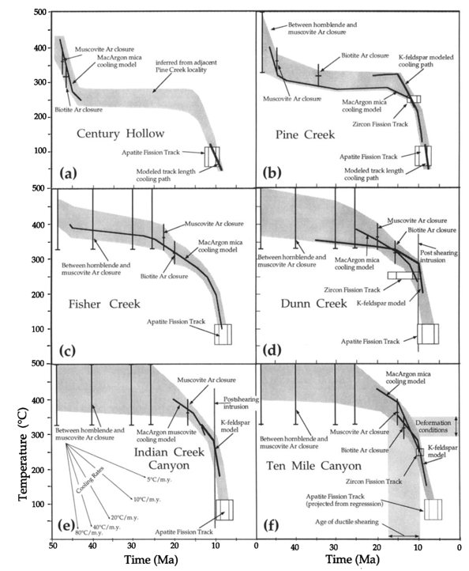
Apatite
Fission-Track Window is roughly 13.5 - 7.4 MA
Notes:
This also shows when the minerals were brought to the surface or when they reached a cool enough point to crystallize (closer to surface)

Slide 12
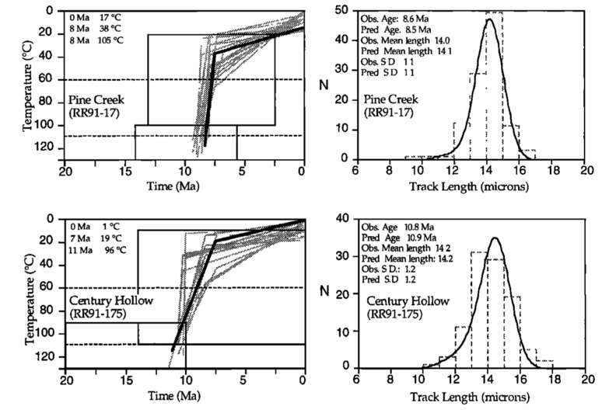
Apatite, cont.
Fission-Track Window is roughly 13.5 – 7.4 MA
Pine Creek and Century Hollow show the boundaries of active Miocene MCC exhumation- 13.5 MA in the west, 7.4 MA in the east

Slide 13
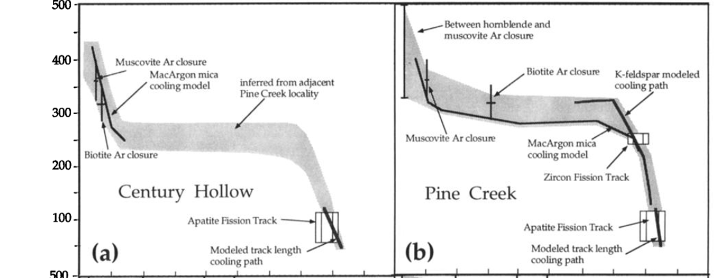
2 Episodes of Exhumation?

Slide 14
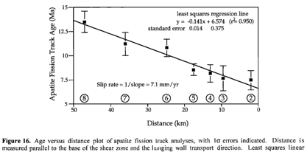
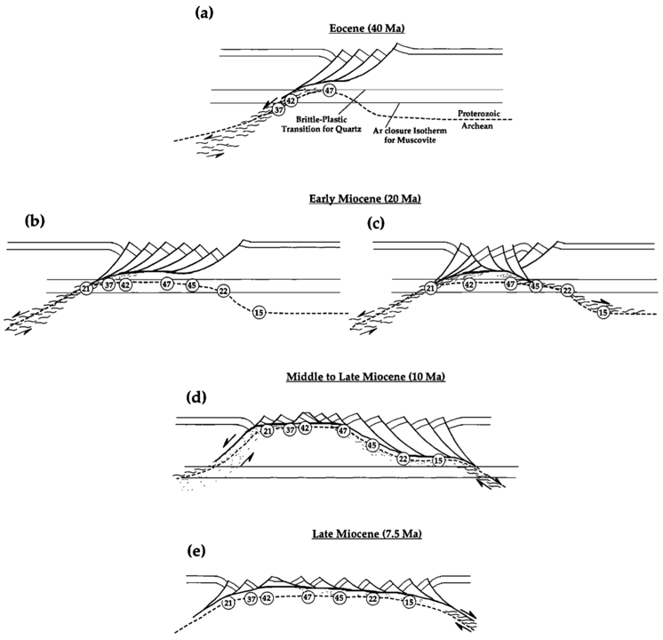
Conclusions
Cenozoic cooling of the Precambrian Rocks in the Raft Rivers was attributed to 2 distinct detachment fault systems, kicked off by 2 distinct events/episodes of activity:
Middle Eocene time in west part of range (Middle Mountain Shear Zone)
13.5 – 7.4 MA in central/east part of range (also reactivated in west) (Raft River Detachment)

